Slide 1
Define a force

Slide 2
Fill in the blank.
Whenever there is a change in a motion,
a __________ has acted

Slide 3
A force can be measured using what device?

Slide 4
List 5 ways a force can change motion

Slide 5
In this image, are the forces balanced or unbalanced?

Slide 6
PUSH, PULL OR A TWIST
Define a force

Slide 7
FORCE
Fill in the blank.
Whenever there is a change in a motion,
a __________ has acted

Slide 8
SPRING BALANCE
A force can be measured using what device?

Slide 9
START SOMETHING MOVING, ACCELERATION, STOP SOMETHING, DECELERATION, AND CHANGE DIRCTION
List 5 ways a force can change motion

Slide 10
UNBALANCED
In this image, are the forces balanced or unbalanced?

Slide 11
Match the term to this definition
The tendency to resist any change in motion

Slide 12
With an increase in ____________,
there is an increase in inertia

Slide 13
Give an example of contact force and a non-contact force

Slide 14
Define a contact force

Slide 15
What is the term that matches this definition:
A force that acts in the opposite direction to the motion

Slide 16
INERTIA
Match the term to this definition
The tendency to resist any change in motion

Slide 17
MASS
With an increase in ____________,
there is an increase in inertia

Slide 18
CONTACT: FRICTION, NON-CONTACT: MAGNETIC, GRAVITY, ELECTROSTATIC
Give an example of contact force and a non-contact force

Slide 19
FORCE THAT ACTS BETWEEN TWO SURFACES THAT ARE IN CONTACT
Define a contact force

Slide 20
FRICTION
What is the term that matches this definition:
A force that acts in the opposite direction to the motion

Slide 21
What are the two things that friction depends on?

Slide 22
Give one example of a useful friction

Slide 23
Give one example of an unwanted friction

Slide 24
List the four different ways that friction can be reduced

Slide 25
What feature in the car increases the amount of time for the car to crash?

Slide 26
MASS AND SURFACE ROUGHNESS
What are the two things that friction depends on?

Slide 27
WALKING
Give one example of a useful friction

Slide 28
MACHINES
Give one example of an unwanted friction

Slide 29
WHEELS, LUBRICANT, REMOVE CONTACT, STREAMLINE SHAPE
List the four different ways that friction can be reduced

Slide 30
CRUMPLE ZONE
What feature in the car increases the amount of time for the car to crash?

Slide 31
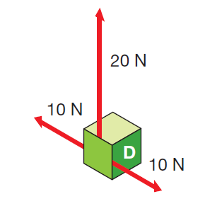
In the following image, what is the overall size and direction of the overall force?

Slide 32
Define gravity

Slide 33
Define a non-contact force

Slide 34
Define mass

Slide 35
Define weight

Slide 36
20N UPWARDS
In the following image, what is the overall size and direction of the overall force?

Slide 37
FORCE OF ATTRACTION BETWEEN TWO OBJECTS
Define gravity

Slide 38
A FORCE THAT ACTS OVER A DISTANCE, THROUGH A FORCE FIELD
Define a non-contact force

Slide 39
THE AMOUNT OF MATTER IN AN OBJECT
Define mass

Slide 40
THE FORCE OF GRAVITY ON AN OBJECT
Define weight

Slide 41
If it was to move to a new planet what would change: Mass or weight?

Slide 42
Name the four forces acting on an aircraft

Slide 43
Define terminal velocity

Slide 44
If I dropped a cricket ball and shot-put at the same time (assuming they are the same size) would they land at the same time or at different times?

Slide 45
Draw a skydiver jumping out of a plane, include the vertical arrows of force and terms required.

Slide 46
WEIGHT
If it was to move to a new planet what would change: Mass or weight?

Slide 47
THRUST, DRAG, WEIGHT, LIFT
Name the four forces acting on an aircraft

Slide 48
WHEN AN OBJECT FALLS AT A CONSTANT SPEED
Define terminal velocity

Slide 49
SAME TIME
If I dropped a cricket ball and shot put at the same time (assuming they are the same size) would they land at the same time or at different times?

Slide 50
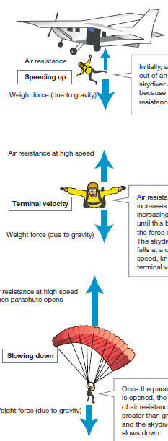

Slide 51
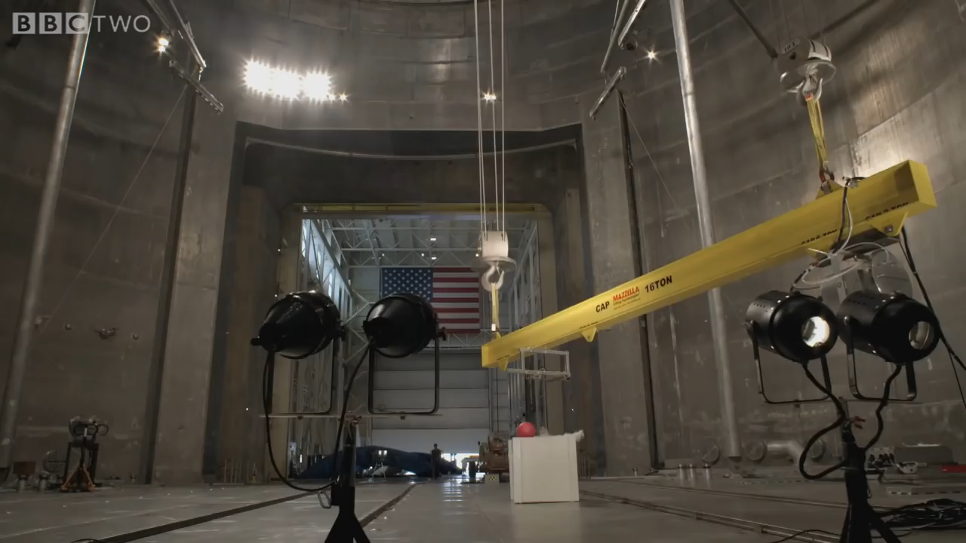

Slide 52
What is Energy?

Slide 53
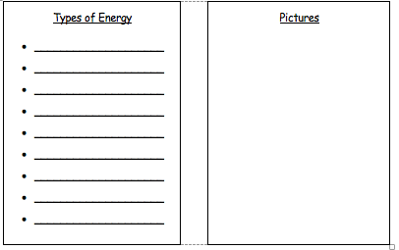
Types of Energy
YOUR TASK: Learn everything you need to know about energy in detail with Dr Binocs.
As you watch the video about energy, create a list of different types of energy.
Once you have your list, draw pictures to help you remember the different forms of energy

Slide 54
https://www.youtube.com/watch?v=CW0_S5YpYVo

Slide 55
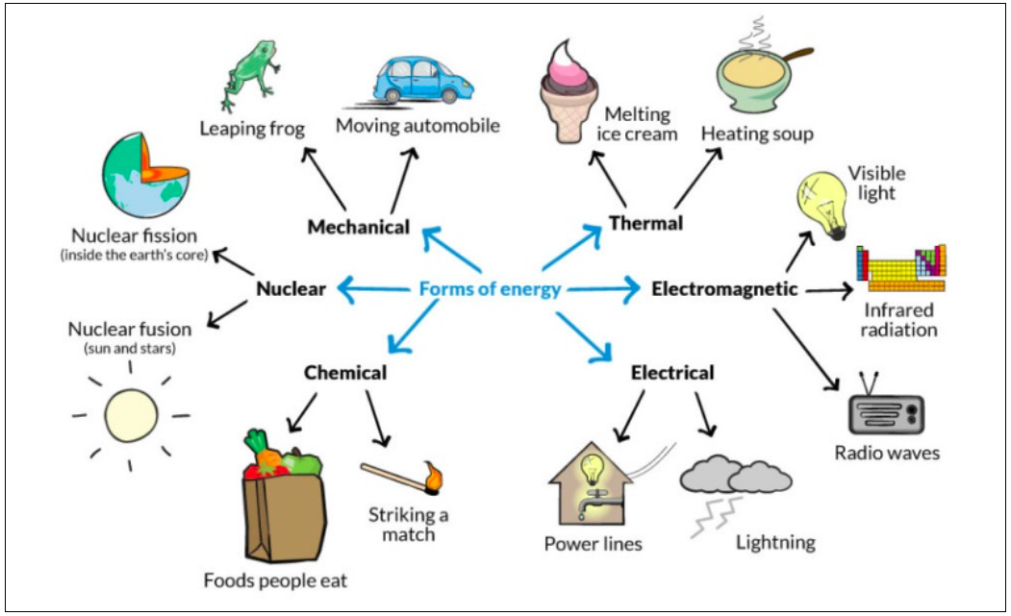

Slide 56
Potential and Kinetic
All types of energy can be categorized into two groups: potential & kinetic.
Mechanical energy is a mix of kinetic (energy in motion) and potential energy (energy that is stored).
The sum of an object’s kinetic and potential energy equals the object’s total mechanical energy.

Slide 57
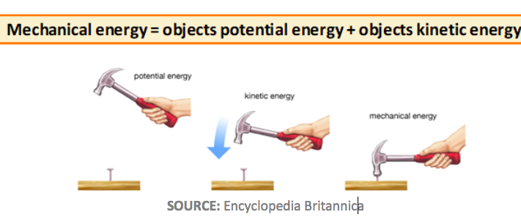
Sum of mechanical energy

